Slide 1
Targeting KRAS Mutant Cancers Using Modified Anthrax Toxin
Rose Patrick
Liu Lab, Aging Institute
SURP Summer Undergraduate Research Program - Pitt Department of Medicine
Lab: Shihui Lui, Zehua Zuo, Zhihao Sun

Slide 2
Cancer and KRAS Mutations
In 2020 there were 1.8 million new cases of cancer in the United States
1 in 7 of all human cancers are associated with KRAS mutations
KRAS is a protein part of the RAS/MAPK pathway which is required for cell growth and proliferation
When mutated, can lead to uncontrolled growth and cancer
Notes:
Image of KRAS
https://en.wikipedia.org/wiki/KRAS
KRAS can be bound to GDP or GTP, it is in its active ON state when bound to GTP
Should I include a graphic of the pathway here or maybe on the next slide?

Slide 3
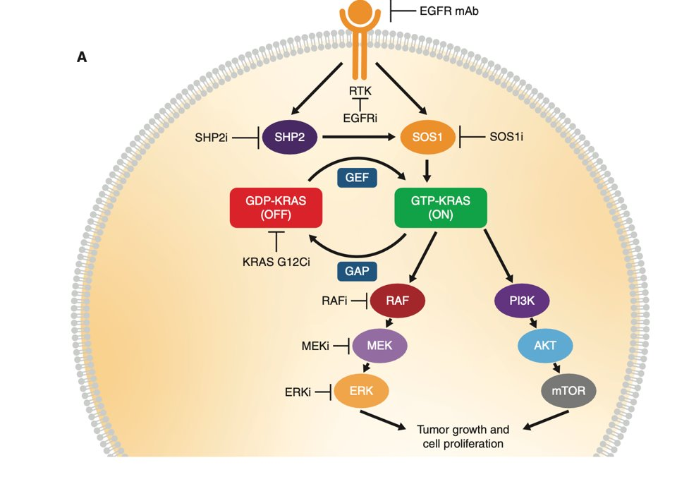
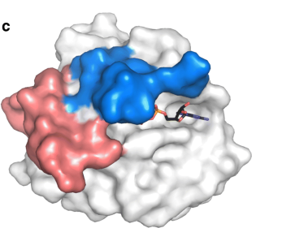
KRAS is an essential protein in the MEPK pathway for cell proliferation
Nyíri, K., Koppány, G. & Vértessy, B.G. Structure-based inhibitor design of mutant RAS proteins—a paradigm shift. Cancer Metastasis Rev 39, 1091–1105 (2020).
Notes:
Our treatment
Have an image of KRAS and then us cutting it
Maybe include the pathway here
And then a red cleavage of us cutting KRAS?
Explain that there is not a clear distinctive area which is plausible for covalent inhibition, so cleaving this protein is a good second best.
INCLUDE citation of the flow chart from the journal club paper
Maybe have the images go up one at a time and mention how we cleave the KRAS protein here in our treatment

Slide 4
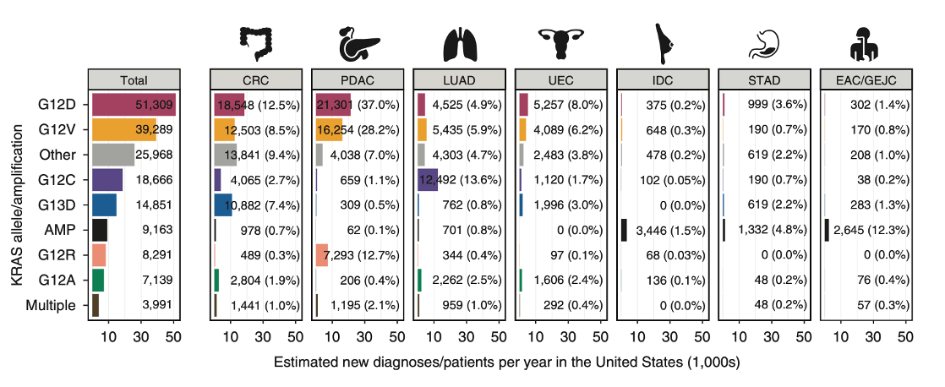
Current KRAS therapeutics target G12C mutants, and leave majority of KRAS mutations untreated
KRAS was previously deemed to be untreatable
Current treatments include covalent inhibition of G12C mutations
Notes:
With a filled in image of KRAS you can show that there is no current motif that a covalent bond would be able to hit.
Maybe change this so that is comes up as a transition with the red box

Slide 5
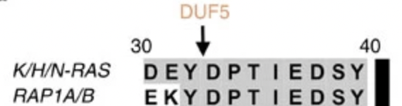
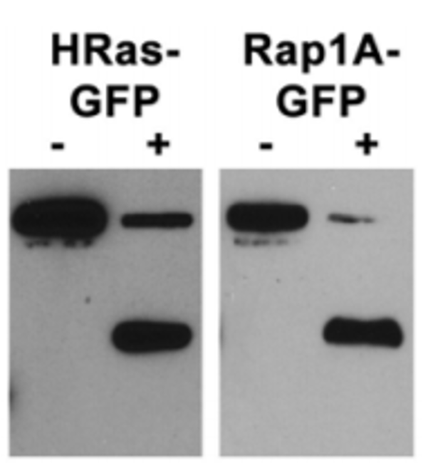

The effector domain DUF5 of lethal factor proteins cleave RAS family proteins
Uncleaved
Cleaved
Antic, I., Biancucci, M., Zhu, Y. et al. Site-specific processing of Ras and Rap1 Switch I by a MARTX toxin effector domain. Nat Commun 6, 7396 (2015).
Notes:
How do we cleave it?
Is this talking about our Lethal Factor?
Lethal factor background! Look into Rachel's slide 5. it says that lethal factor naturally cleaves KRAS at a certain spot, which likely had the original intent to stop the body's ability to fight back from an anthrax invasion/infection
We use protein lethal factor to cleave the KRAS. This is independent of the KRAS mutation in question – inactivating the downstream pathway
Include an image of what lethal factor usually cleaves
And then include and image of what our modifies lethal factor does and cleave
Does lethal factor normally have DUF5 on it?

Slide 6
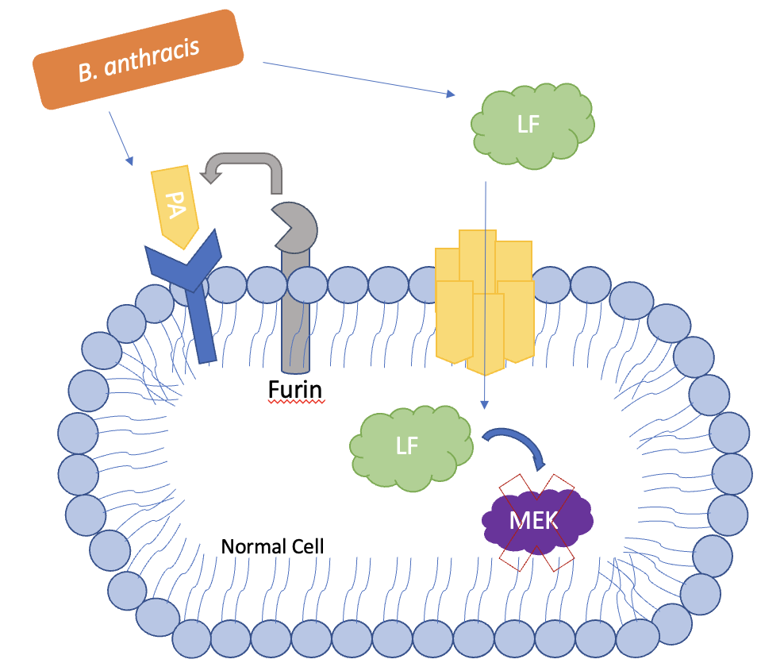
Bacillus anthracis releases anthrax toxin which produces protective antigen (PA) and lethal factor (LF)
Notes:
Anthrax toxin
Give Rachel credit if I do not remake this.
Make my own graphic
Anthrax normally entering the cell
Include it cleaving KRAS, or a protein in MEPK once it enters the cell

Slide 7
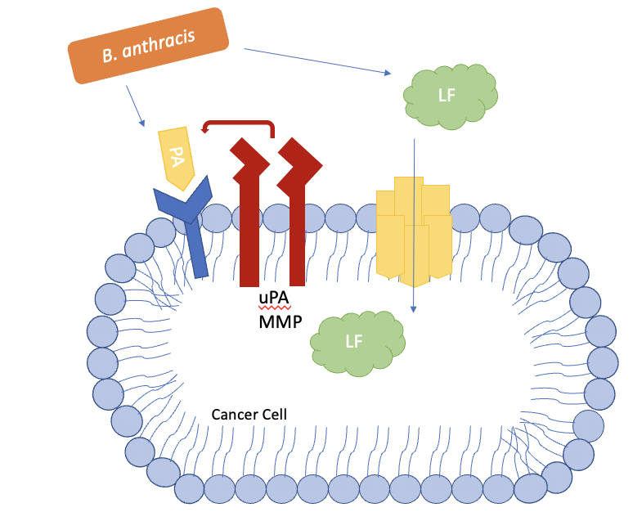
Protective antigen PA of anthrax toxin can be altered to target tumor cells
Notes:
Specific PA
Cleaved only by proteases that are more prevalent in cancerous cells
Maybe try to find the numbers or which cell types Furin vs the other proteases are on

Slide 8
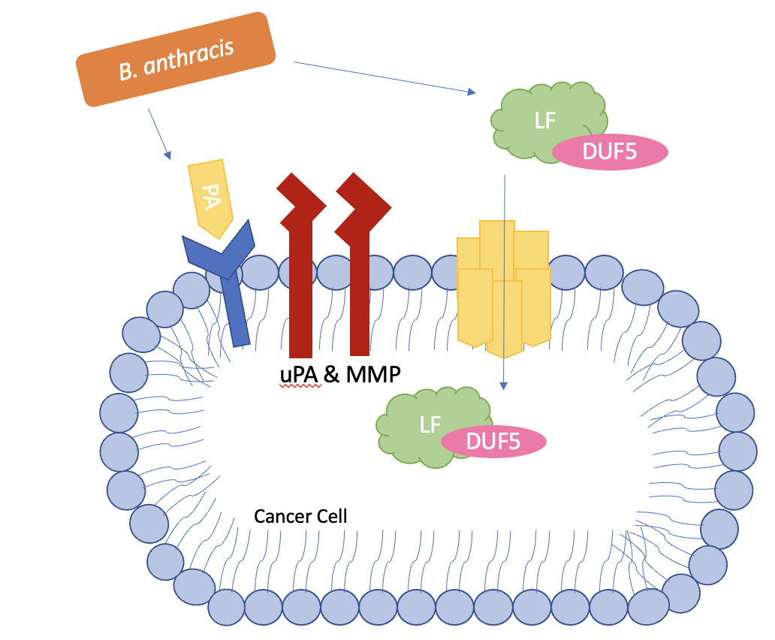
Lethal Factor can be modified with effector domain DUF5 to cleave downstream RAS family proteins

Slide 9
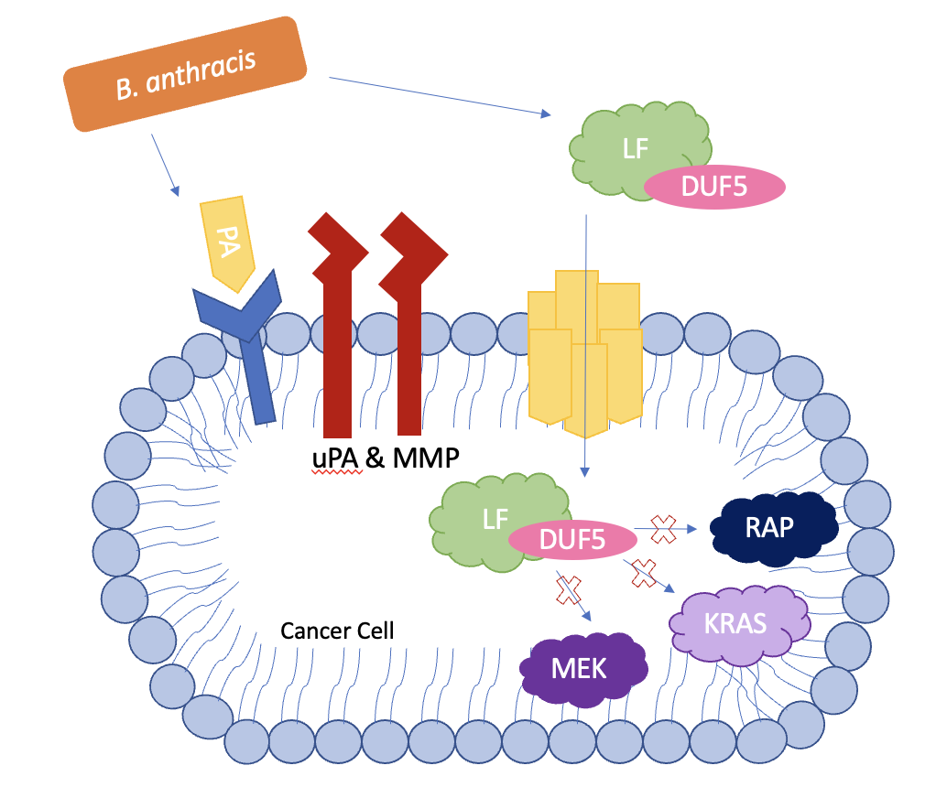
Lethal Factor can be modified with effector domain DUF5 to cleave downstream RAS family proteins

Slide 10
DUF5 effector domain of lethal factor protein can be modified for selective protein cleavage
We are looking for a lethal factor protein which ...
Selectively cleaves KRAS
Has a low toxicity for therapeutic use
Notes:
Why are we looking to selectively cleave just KRAS?

Slide 11
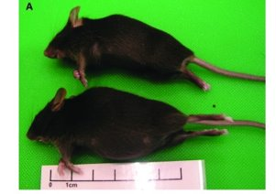
LFnDUF5 can cleave RAP1B and lead to unintended distended abdomens in mice
Johnson, Linda K et al. “Abdominal Distension and Escherichia coli Peritonitis in Mice Lacking Myeloid Differentiation Factor 88.” Comparative medicine vol. 65,2 (2015): 123-6.
Notes:
Limitations of our research
How lethal toxin can also cleave RAP1B
My goal throughout this summer was to try and find a toxin which 1) cleaved RAS and not RAP1B and 2) had a low enough toxicity so that it was safer to be used therapeutically.
In this slide – include RAP1B and then next or also on this slide include images of the Cleavage Assays (Western Blots?)
Can also include an image of the distended abdomen (explain how this is fluid filled and can be removed from the mice safely, but this is an unwanted side effect, so moving forward we are looking at strictly RAS cutting rather than RAP1B cleaving.

Slide 12
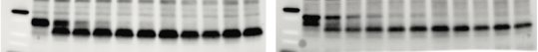
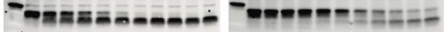
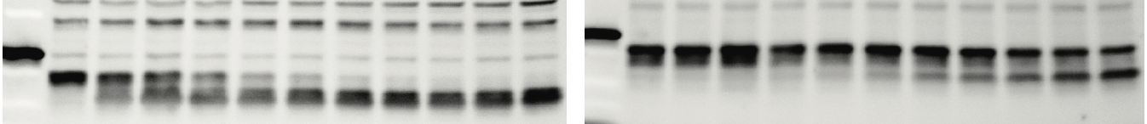
Variants of mutated DUF5 on lethal factor can selectively cleave RAS rather than RAP1B
RAS
RAP1B
LFnDUF5
LFnDUF5 #137
LFnDUF5 #174
Notes:
How can we test that this effectively controls tumor growth?
Ask doctor Liu for more information about how we construct the different lethal factors
Green means cleaved
Red means uncleaved
Explain that lots of my work was preparing western blots
We used WHAT TYPE of cancer cells here.
Is this the alanine scan?
The alanine scan is changing different amino acids in the Lethal Factor LF to alanine and hoping to see which amino acids are important (do we want the lethal factor to be non-functional then since we are making the amino acid something else showing that the amino acid in that spot is important, or do we want the cleavage to still occur, showing that isn't the most important amino acid for this cleavage?)

Slide 13
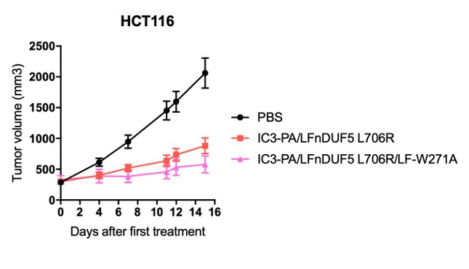
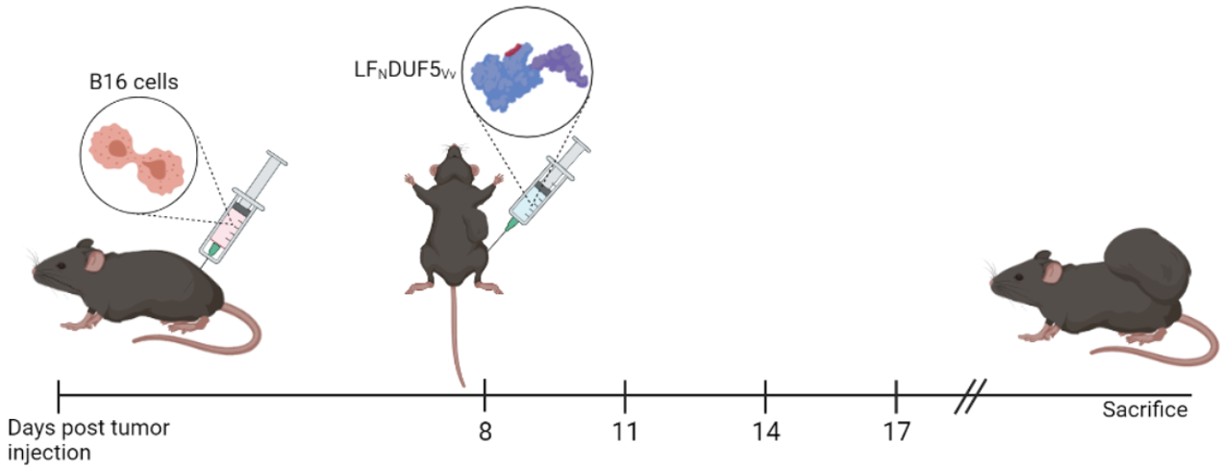
Lethal factor #137 effectively decreases tumor sizes in mice
HCT116 Cells
Notes:
Model is toxin 137 which we showed in the last slide only cleaved RAS more than RAP1B
What about the toxicity?
HCT116 cells
Are colorectal cancer cells from males
In mice, #137 was able to keep down tumor size, compared to our control mice which were injected with PBS.
But is there a way to make this plausible for therapeutic use spread throughout the body at a highe nough dose to still reach the cancerous cells?
Maybe have the graph come up last.

Slide 14
Modified lethal factors show potential for therapeutic use with lower toxicities
Toxin Variant | RAS | RAP1B | Toxicity
LFnDUF5 | +++ | +++
LF #137 | +++
LF #128 | +++
Notes:
Maybe remove this slide and instead show the whole process again with the modified Lethal Factor and Protective Antigen so that it is only infecting cancer cells and only cleaving for RAS (not RAP), and then is stopping tumor growth in the mice models.
Cytotoxicity
- I need to include a comparison for different generations of this toxin
Maybe include the second cytotoxicity assay to show that we are leaning towards this toxin next time in mice because it has a higher cell viability.
Maybe just reference these by their #numbers. And can mention that the different #numbers mean that they are mutating different amino acids in the lethal factor
Should I include the cytotoxicity of the 2nd generation here in this graph?
Mentioned at one point maybe including a graph from the toxicity of the original toxin in the mice and how they died fairly early

Slide 15
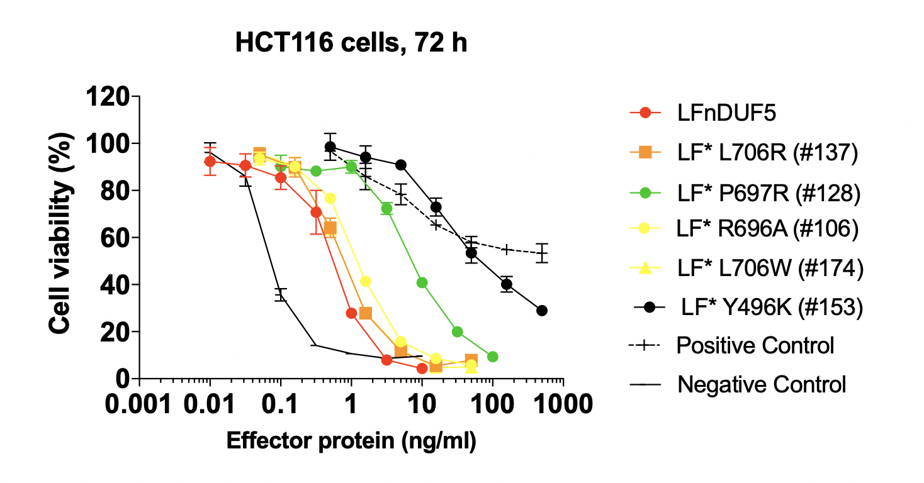
Modified lethal factors show potential for therapeutic use with lower toxicities
Toxin Variant | RAS | RAP1B | Toxicity
LFnDUF5 | +++ | +++ | +++
LF #137 | +++ |  | +++
LF #128 | +++ |  | +
Notes:
Cytotoxicity
- I need to include a comparison for different generations of this toxin
Maybe include the second cytotoxicity assay to show that we are leaning towards this toxin next time in mice because it has a higher cell viability.
Maybe just reference these by their #numbers. And can mention that the different #numbers mean that they are mutating different amino acids in the lethal factor
Should I include the cytotoxicity of the 2nd generation here in this graph?
Mentioned at one point maybe including a graph from the toxicity of the original toxin in the mice and how they died fairly early

Slide 16
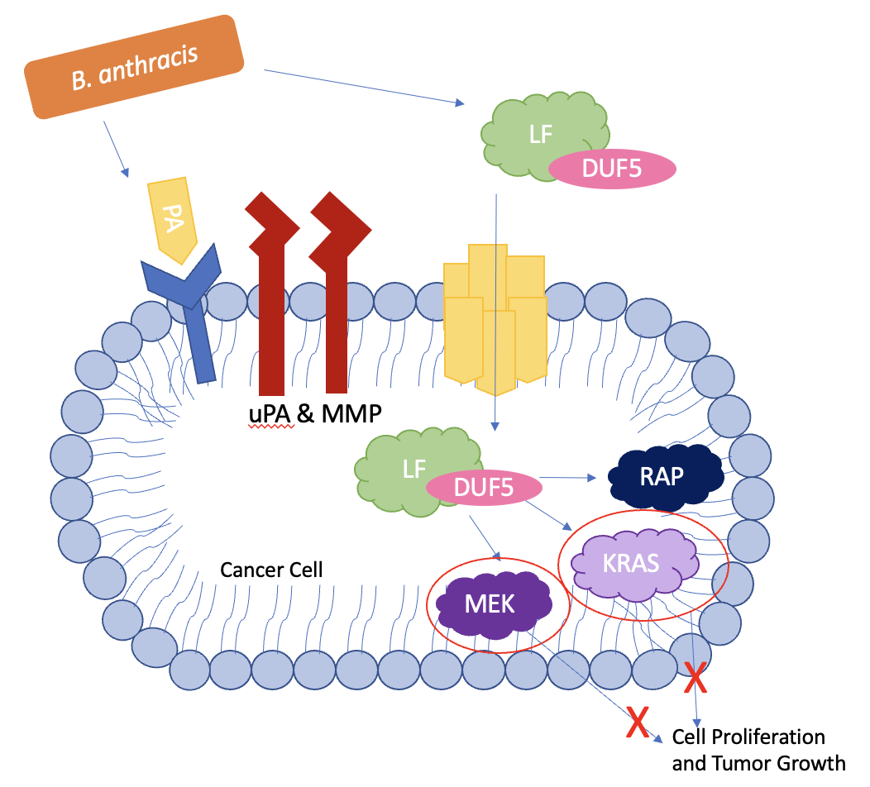
Ongoing Work
Develop a LFnDUF5 variant which is...
KRAS specific
Low toxicity
Successfully decreases tumor size in mice

Slide 17

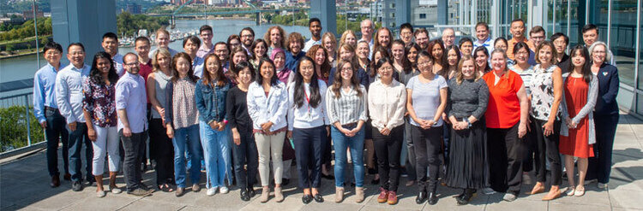


Acknowledgements
Liu Lab –
Shihui Liu, MD, PhD; Zehua Zuo, Phd; Zhihao Sun, PhD
University of Pittsburgh Aging Institute
SURP –
Summer Undergraduate Research Program, Microbiology Department

